Slide 1
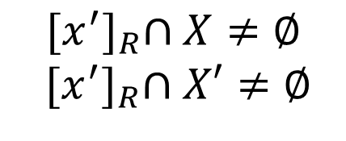
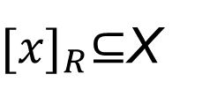
GRANULAR SPACES IN THE PAWLAK ROUGH SET MODEL
$$G_{R_{d}}$$
$$R_{d}⊆U×U$$
$$G_{R}$$
$$R⊆U×U$$
$$X$$
$$X′$$
${[x]}_{R}⊆$X
$${[x]}_{R}$$
$${[x′]}_{R}$$
$${[x^{′}]}_{R}∩X≠∅$$
$${ [x^{′}]}_{R}∩X′≠∅$$
$$X,X′∈U/R_{d}$$

Slide 2

GRANULAR SPACES IN THE PAWLAK ROUGH SET MODEL
$DS=(U,A,d)$; ${ A}^{′}εP(A)$
$$G_{A}=\left\{{\left[x\right]}_{IND(A)}:xεU\right\}$$
$$G_{P(A)}=\left\{{\left[x\right]}_{IND\left(A^{′}\right)}:xεU \&{ A}^{′}⊆A\right\}$$
$$G_{d}=\left\{{\left[x\right]}_{IND(d)}:xεU\right\}$$
$$[{x]}_{IND(A)}⊆[{x]}_{IND(A^{′})}$$
$${[x′]}_{IND(A^{′})}⊆X$$
$${[x]}_{IND(A^{′})}$$
$$X′$$
$${[x]}_{IND(A)}$$
$${[x′]}_{IND(A^{′})}$$
$${[x′]}_{IND(A)}$$
$$X$$
$${[x′]}_{IND(A)}⊆{[x′]}_{IND(A^{′})}$$
$${[x′]}_{IND(A^{′})}∩X≠∅$$
$${[x′]}_{IND(A^{′})}∩X′≠∅$$
$$X,X′∈U/R_{d}$$

