Slide 1



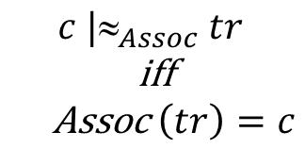





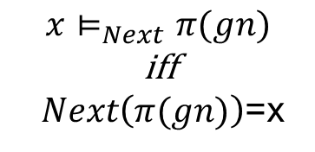



IP-MORPHISM (INFO-PHYSICAl MORPHISM)
OF C-GRANULE CONTROL
$informational layer$ (il)
$physicalal layer$ (pl)
il
pl
$$spec$$
$$tr$$
$$π(gn)$$
$$x⊨_{Next}π(gn)$$
iff
$Next\left(π(gn)\right)$=x
$$c |_{Assoc} tr$$
iff
Assoc$\left(tr\right)=c$
$$Assoc$$
by
IM
$$Next$$
il
$$percep(c)$$
$$percep$$
pl
$$c$$
$$x$$
$dist$(percep(Assoc(spec($π$(gn)))),Next($π$(gn))) is acceptable

