Slide 1
A Molecular Phylogeny of Living Primates
Polina Perelman, Warren E. Johnson, Christian Roos, Hector N. Seuanez, Julie E. Horvath, Miguel A. M. Moreira, Bailey Kessing, Joan Pontius, Melody Roelke, Yves Rumpler, Maria Paula C. Schneider, Artur Silva, Stephen J. O’Brien, Jill Pecon-Slattery.
Michał Zgieb

Slide 2
Introduction
Research Objective:
Develop a high-resolution phylogeny of primates.
Use genomic data to standardize and verify primate systematics.
Identify patterns of genome evolution, adaptation, and speciation.
Issues with Previous Primate Systematics:
Controversies and lack of consensus regarding evolutionary hierarchy, especially at the species level.
Previous phylogenetic classifications were primarily based on morphology and single-gene analyses.
High species diversity (261–377 species) and numerous genera requiring updates and systematic revision.

Slide 3
Methodology in the publication
Samples:
186 primate species (61 genera, ~90% of known genera).
Outgroup species: Dermoptera, Scandentia, Lagomorpha.
Genes: 54 nuclear genes (~8 Mb).
DNA extraction: Performed from whole blood, buffy coat, hair, or buccal swab samples.
Sequencing:
Sanger sequencing using ABI PRISM 3730 XL 96-well capillary sequencer (Applied Biosystems).
Sequence Processing:
Alignment: MAFFT (ver 6) – Manual correction in Se-Al.
Filtering: GBLOCK (ver 0.91b) – Removal of ambiguous sequence regions.
Evolutionary Model Selection: ModelTest (ver 3.7) – Based on AIC criterion (GTR+I+G model).
Phylogenetic Analysis:
Maximum Parsimony (MP) and Maximum Likelihood (ML): Implemented using tree-bisection-reconnection (TBR) and GARLI ver 0.96.
Bayesian Analysis: Conducted with BEAST (ver 1.5.3) using the GTR+I+G model; Tracer ver 1.4.1 used for model evaluation.
Results Processing and Tree Visualization:
Software used: LogCombiner (ver 1.5.3), TreeAnnotator (ver 1.5.3), FigTree (ver 1.3.1).

Slide 4
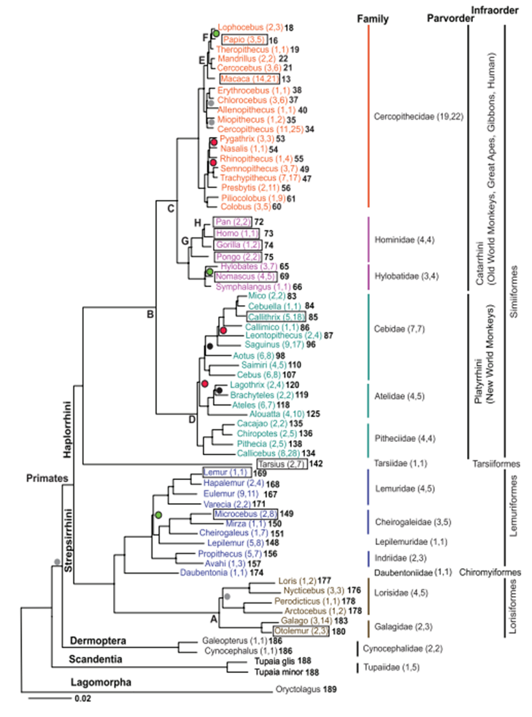
Results from publication
High-Resolution Phylogeny
88% of nodes with BS > 90%
Only 3 polytomies out of 189 nodes
Key Evolutionary Events
Divergence of Strepsirrhini and Haplorrhini (~87 MYA)
Monophyly of Tarsiiformes (tarsiers as a distinct lineage)
Clear diversification of New and Old-World monkeys
Position of Hominidae – humans most closely related to chimpanzees
Adaptation and Speciation
Faster evolution in Lorisidae, slower in Cercopithecoidea
Nocturnal lifestyle in Aotinae
"Phyletic dwarfism" in Callitrichinae
Relevance to Human Research
Reference point for Hominidae evolution
New insights into genome structure and natural selection

Slide 5
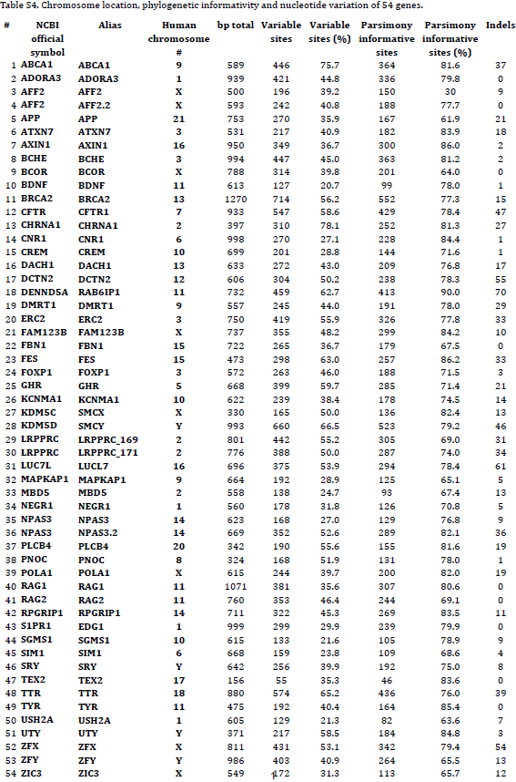
Methodology: Selecting Data
Selected species (12):
Loris tardigradus
Daubentonia madagascariensis
Lemur catta
Ateles hybridus
Lepilemur dorsalis
Pithecia irrorata
Galago thomasi
Homo sapiens
Pongo pygmaeus
Callicebus moloch
Hylobates agilis
Colobus polykomos
Selected markers:
Autosomal markers (DENND5A, AXIN1, FES), X chromosome (POLA1) and Y chromosome (UTY)

Slide 6
Methodology: Data Processing
Sequence Retrieval:
Sequence data obtained from NCBI GenBank.
Sequence Alignment:
Performed using MAFFT.
Marker Concatenation:
Conducted using the script catfasta2phyml.pl.
Phylogenetic Analysis:
MrBayes (GTR+I+G evolutionary model).
IQ-TREE with an automatically selected HKY+F+G4 model.
Visualization:
FigTree used for tree visualization.

Slide 7
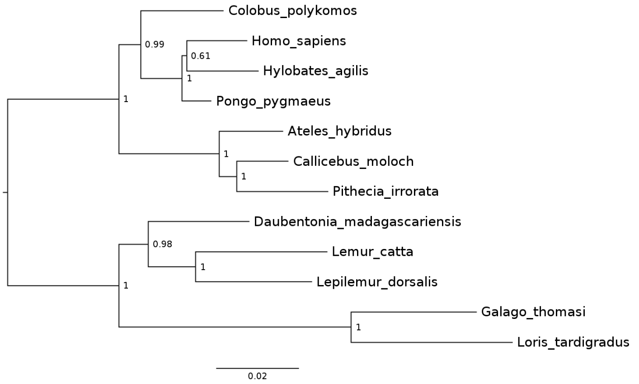
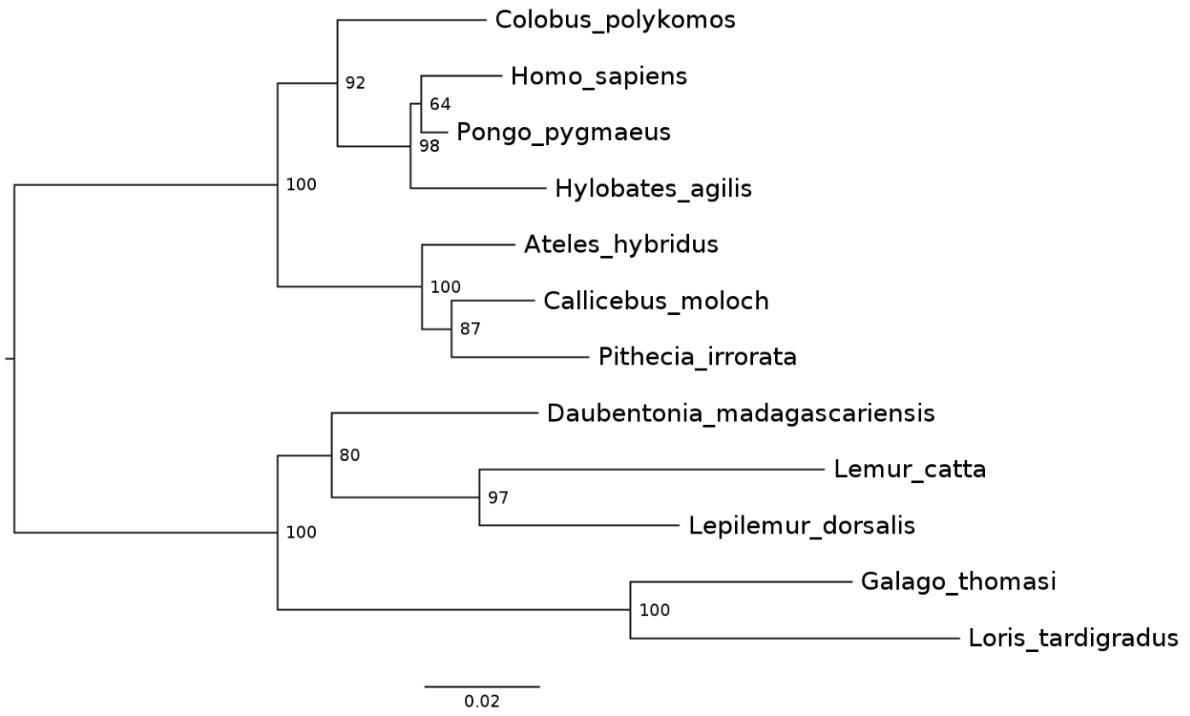
Results: MrBayes vs IQ-TREE
MrBayes
IQ-TREE

Slide 8
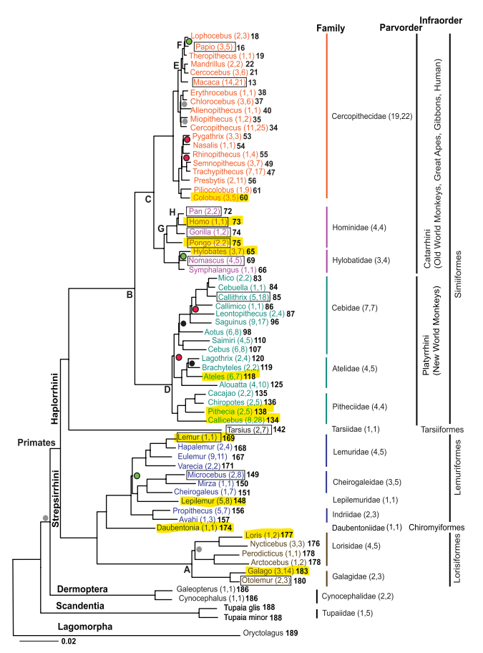
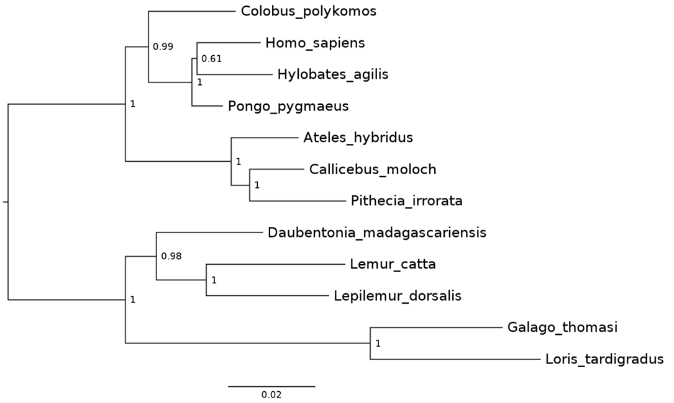
Results: comparison to publication

Slide 9
Conclusions
Confirmation of General Trends:
Despite the limited number of markers and species, the independent analysis largely confirms the main phylogenetic patterns of primates, aligning with the findings of Perelman et al. (2011).
The phylogenetic tree from IQ-TREE reflects fundamental evolutionary trajectories, but the tree from MrBayes, using the evolutionary model from the publication, exhibits connections omo sapiens and Hylobates agilis.
Differences – Impact of Data Selection and Modeling:
Variations in bootstrap support values, divergence time estimates, and branch lengths highlight the sensitivity of results to:
Choice of genetic markers.
Availability of sequence data.
Selected evolutionary models.
Additional Conclusions:
Potential: Enables quick comparison and verification of published findings with limited resources.
Future Direction: Studies with a larger number of markers (54, as in Perelman et al.) are crucial for strengthening conclusions and improving dating accuracy.
Reinforces the importance of comprehensive, data-rich analyses for achieving a complete picture of primate evolution.

Slide 10
Thank you for your attention
Michał Zgieb

