Slide 1
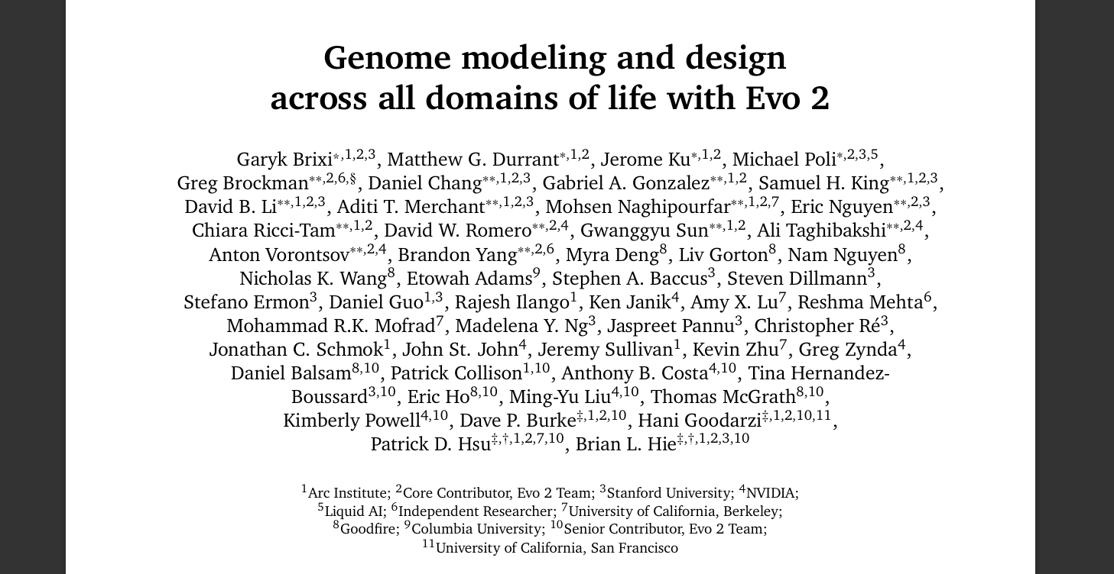
Notes:
Okay so today basically I'm going to talk about the Evo 2 model and this is a big model about 80 gigs of vram you need for this so that's as you can imagine a lot of a lot of gpus so not really a model you're going to be able to deploy on your own but I think it's can help us gain some critical insights about how Transformers can be used in bioinformatics genomic context
these days we all know Transformer networks. I bet most of you do and usually when we think of them we think of obviously chatGPT and deep-seek and models like that that they're basically chat boats when we use them and what they do is process natural language
you might be wondering how that kind of idea can translate to bioinformatics and it turns out it can and this model is a great example to witness that and get to know how Transformers can really process genomic sequences and help us gain some vital actually inside some actually worthwhile inside into structure of life itself of genome itself

Slide 2
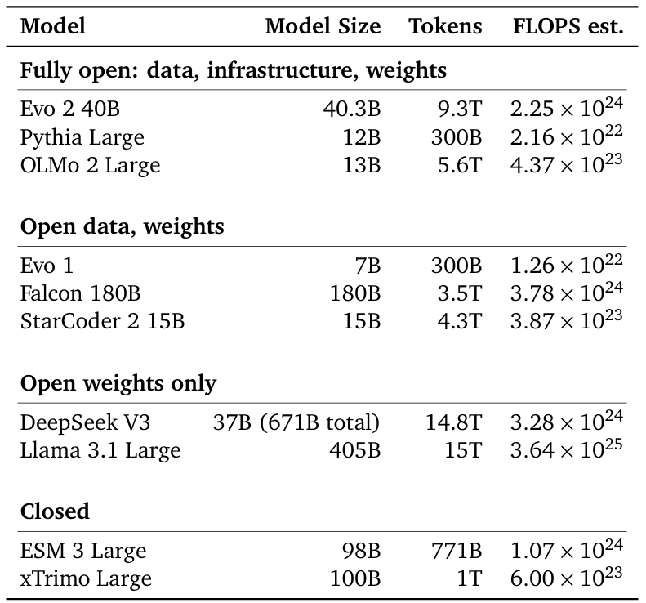
Evo 2 40B
FLOPS - floating point operations. It describes the total computational cost of training the model.
large model: 40.3 billion parameters
hard to run yourself: ~80GB of VRAM needed)
fully open
9.3 trillion training tokens training set (1 token = 1 nucleotide)
novel multi-hybrid architecture StripedHyena 2
“EVO 2 can kind of act like ChatGPT (...) for the genome. “ - Brian Hie (coauthor)

Slide 3
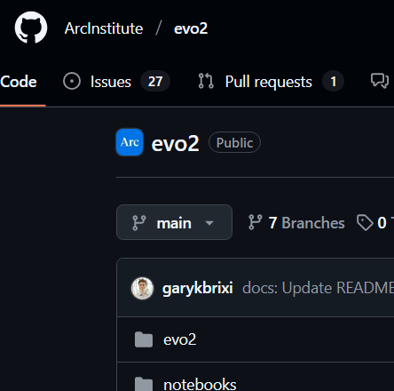
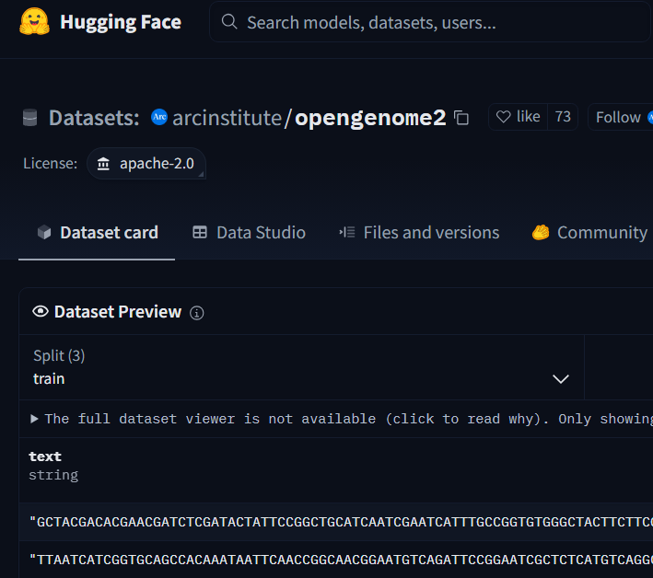
Open-source model
Open dataset

Slide 4
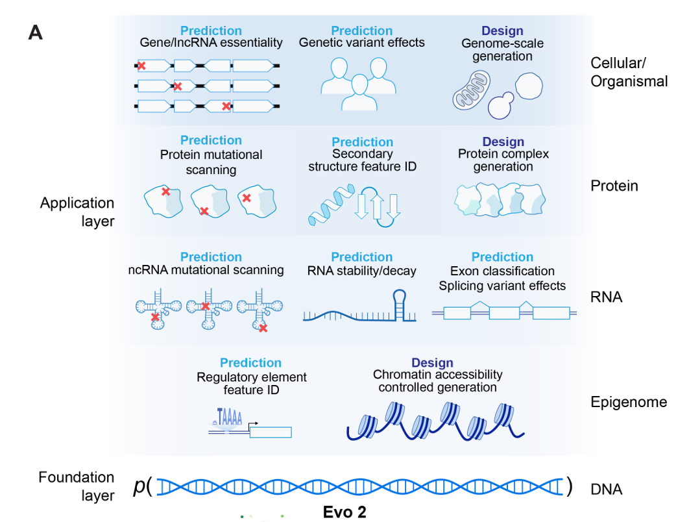
Model uses
Evo 2 models DNA sequence and enables applications across the central dogma, spanning molecular and cellular scales.
Central dogma of molecular biology in a nutshell: DNA makes RNA, and RNA makes protein.

Slide 5
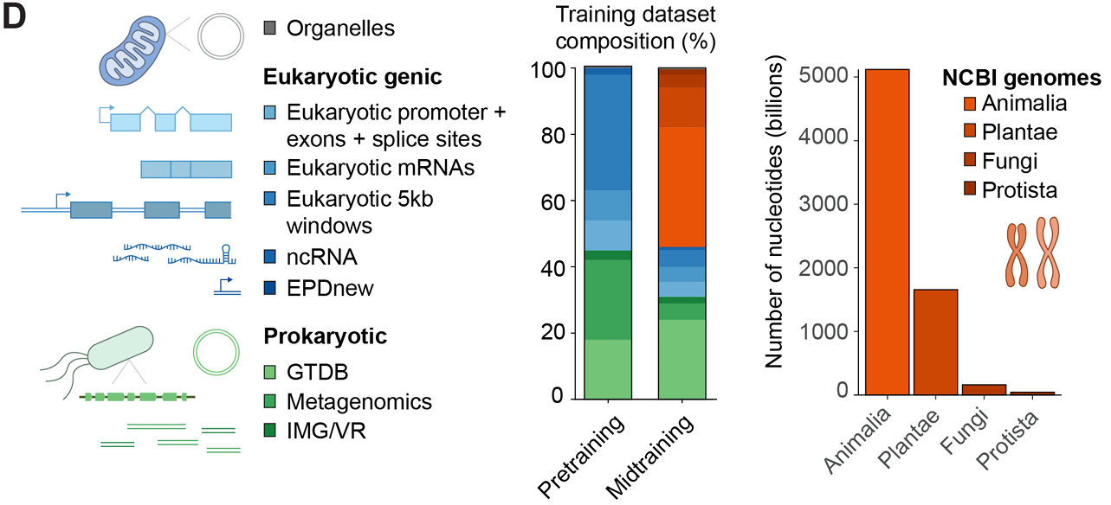
Training dataset
OpenGenome2 - a new dataset compiled from curated, non-redundant nucleotide sequence data, totaling over
8.8 trillion nucleotides from bacteria, archaea, eukarya, and bacteriophage
The dataset contains coding and non-coding sequences within 10,000 base pairs to some known annotated gene. The authors found that this approach yields better performance than training on full genomes.
Notes:
Genome modeling and design across all domains of life with Evo 2 | Garyk Brixi https://www.youtube.com/watch?v=Rarn97Wpl1A

Slide 6
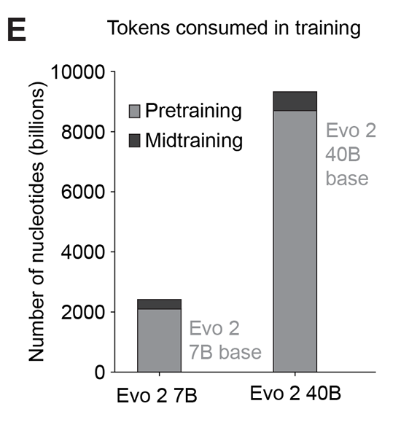
Training procedure: context window
The model is train in phases. Majority of tokens is consumed in the pretraining phase.

Slide 7
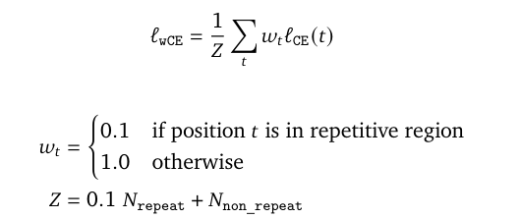
Loss function: weighted cross entropy loss
Repetitions are common in DNA. Repetitive regions are weighted less, so the model treats non-repetitive regions as more important.

Slide 8
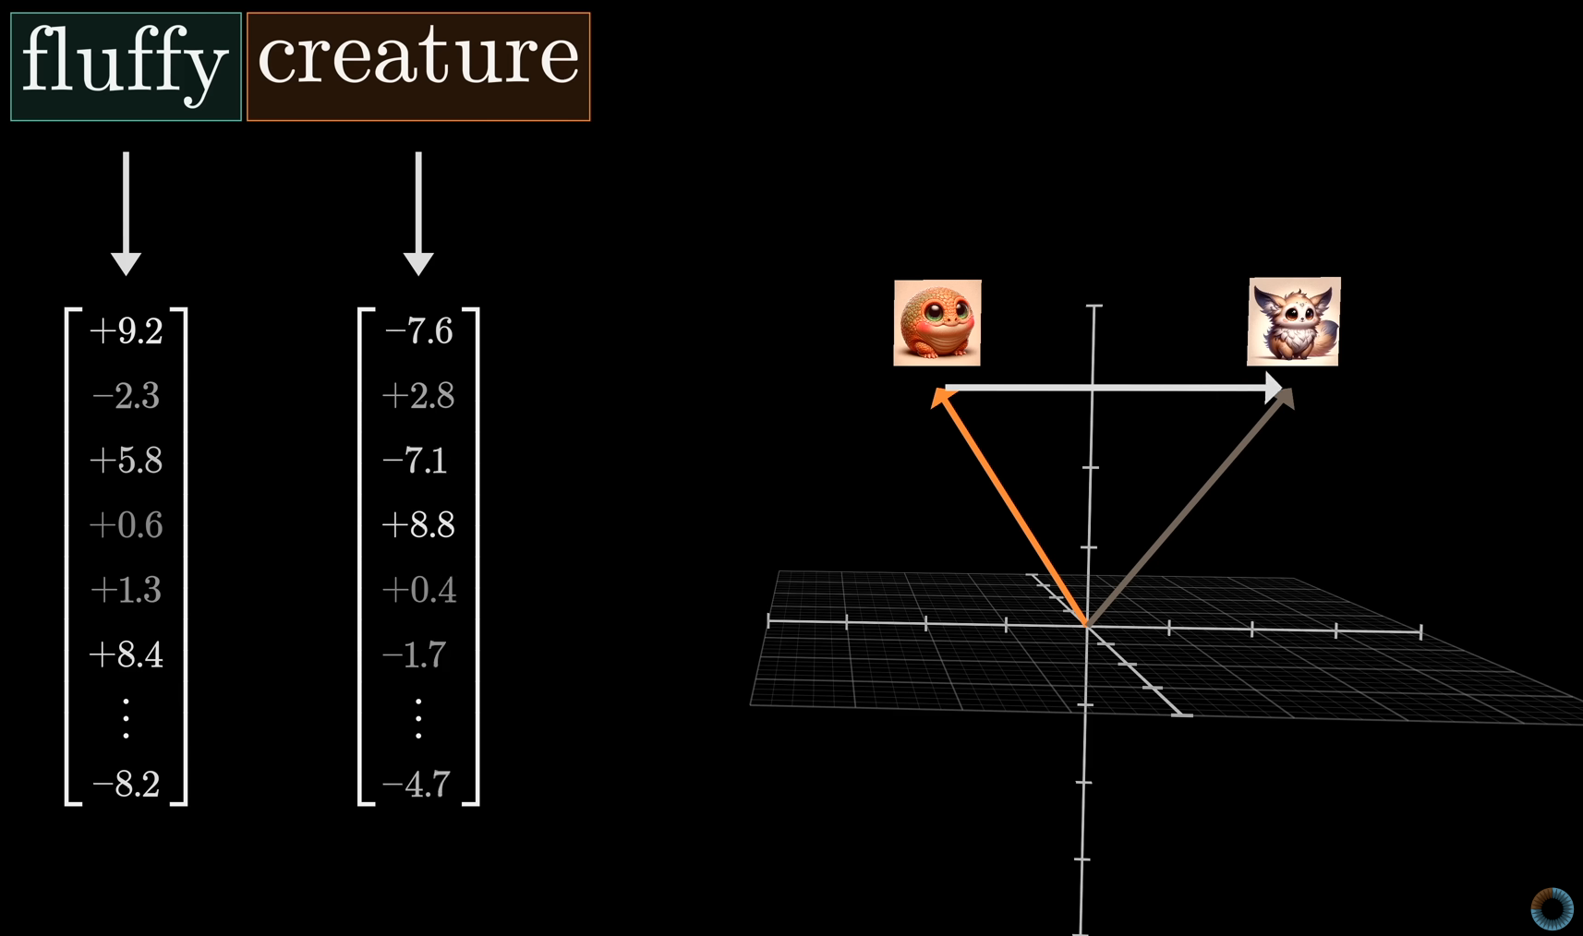
Embeddings
Tokens are the smallest units of data the model processes (words in NLP, nucleotides in Evo).
Embedding means representing each token as a vector in a high-dimensional space.
Does that mean we only have 4 vectors for A, C, T and G?
No. Our embeddings must also encode position in the sequence. They do that using a technique called rotary positional embeddings.
Tokens interact with each other to convey deeper meaning. But how to determine which tokens in a prompt interact with which?
https://www.youtube.com/@3blue1brown “Attention in transformers, step-by-step | DL6”

Slide 9
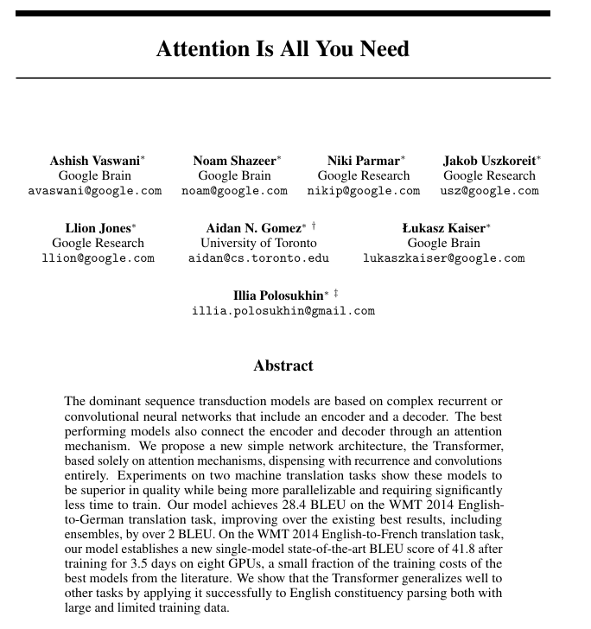
Attention
Vaswani et al. 2017

Slide 10
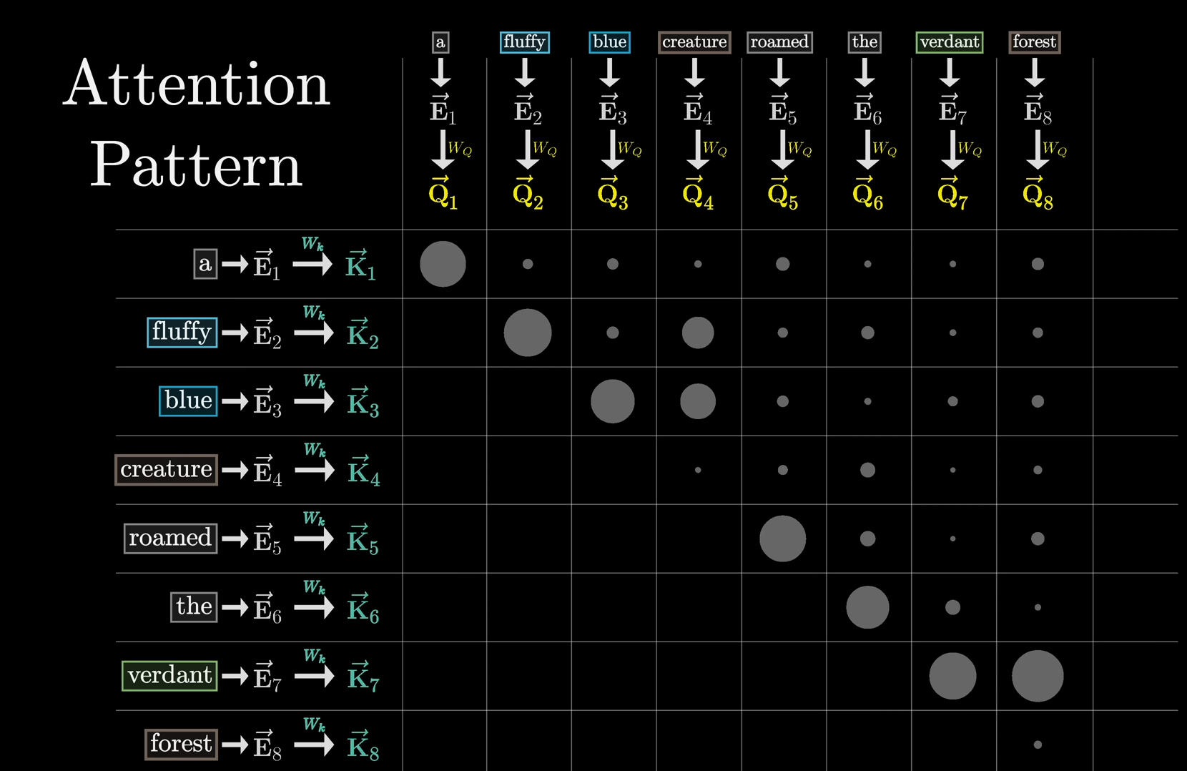
Simple self-attention layer in a nutshell
When computing an attention pattern the model predicts which previous tokens affect a given token.
https://www.youtube.com/@3blue1brown “Attention in transformers, step-by-step | DL6”

Slide 11
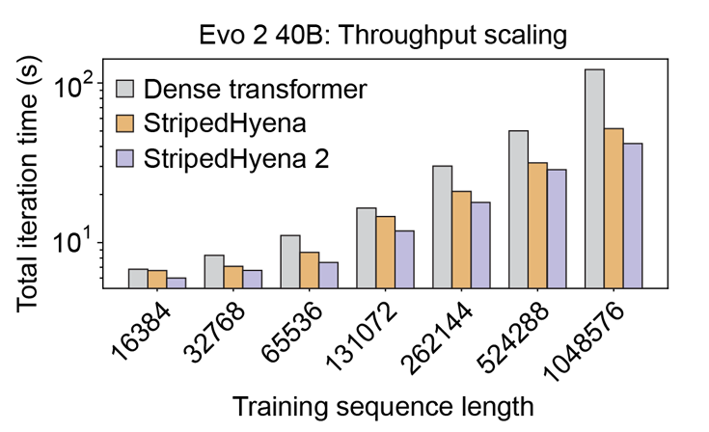
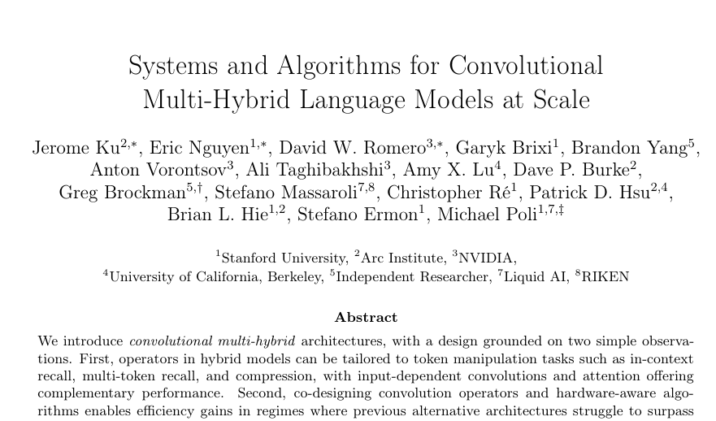
Architecture: StripedHyena2
Main advantages:
better suited for sequences of different length and therefore different tasks
faster training

Slide 12
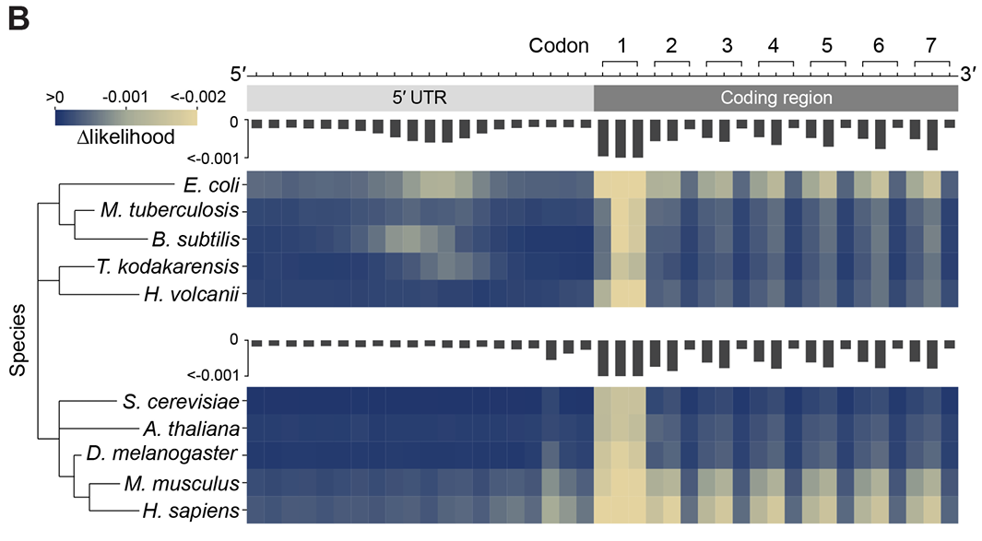
Transformers are generative, so how can they help us classify?
To produce its primary output (a token), the model computes likelihoods for possible tokens that come next.
We can use those likelihoods to make classifiers of various use cases.
The authors investigated the change in likelihood caused by different mutations. Evo 2 predicts mutations to be unlikely in the start codons of protein-coding genes, the first two bases of each codon of the coding region, and the ribosome-binding sites of the 5′ UTR. This example shows us how Evo 2 likelihoods reflect biological function.
Notes:
5′ UTR - five prime untranslated region The 5′ untranslated region (also known as 5′ UTR, leader sequence, transcript leader, or leader RNA) is the region of a messenger RNA (mRNA) that is directly upstream from the initiation codon.

Slide 13
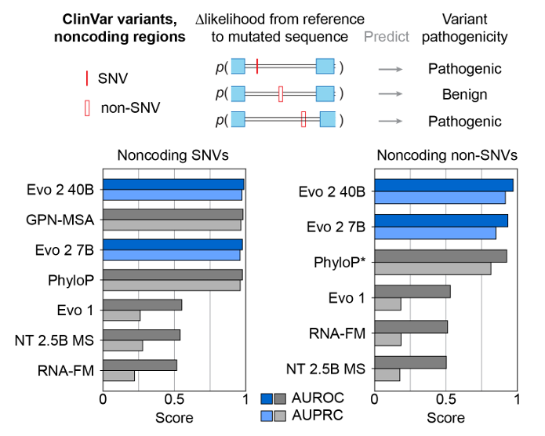
How good is the classification?
Comparison with existing models in classification of variant pathogenicity on ClinVar dataset.
ClinVar is a freely accessible, public archive of reports of human variations classified for diseases and drug responses, with supporting evidence.

Slide 14
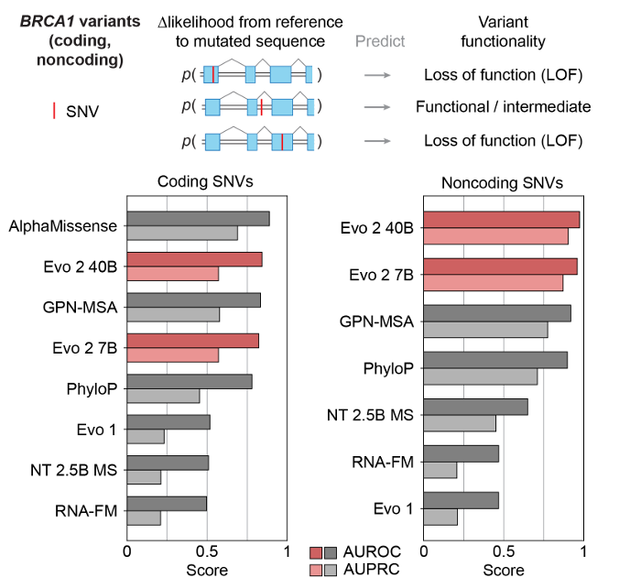
How good is the classification?
Comparison with existing models in classification of pathogenicity of BRCA1 gene variants.
BRCA1 is a human tumor suppressor gene (also known as a caretaker gene) and is responsible for repairing DNA. It encodes breast cancer type 1 susceptibility protein.
AlphaMissense was trained exclusively on human data, Evo 2 was not.

Slide 15
References
Brixi, Garyk, Matthew G. Durrant, Jerome Ku, Michael Poli, Greg Brockman, Daniel Chang, Gabriel A. Gonzalez, et al. “Genome Modeling and Design across All Domains of Life with Evo 2.” Genomics, February 21, 2025. https://doi.org/10.1101/2025.02.18.638918.
Ku, Jerome, Eric Nguyen, David W. Romero, Garyk Brixi, Brandon Yang, Anton Vorontsov, Ali Taghibakhshi, et al. “Systems and Algorithms for Convolutional Multi-Hybrid Language Models at Scale.” arXiv, February 25, 2025. https://doi.org/10.48550/arXiv.2503.01868.
Vaswani, Ashish, Noam Shazeer, Niki Parmar, Jakob Uszkoreit, Llion Jones, Aidan N. Gomez, Lukasz Kaiser, and Illia Polosukhin. “Attention Is All You Need.” arXiv, August 2, 2023. https://doi.org/10.48550/arXiv.1706.03762.
“Genome modeling and design across all domains of life with Evo 2 | Garyk Brixi” https://www.youtube.com/watch?v=Rarn97Wpl1A
“Attention in transformers, step-by-step | DL6” https://www.youtube.com/@3blue1brown

