Slide 1
MMseqs2 ultrafast and sensitive sequence comparison

Slide 3
Reference Overload

Slide 5
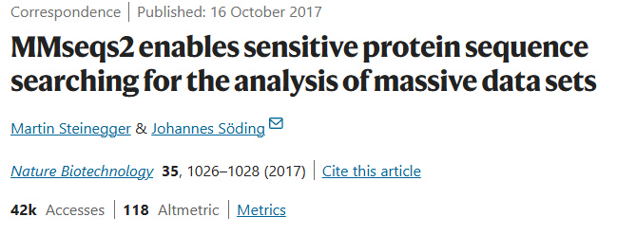
MMseqs2 ultrafast and sensitive sequence comparison

Slide 6
„A good prefilter reduces the search space by a factor of 10^5 while losing few true positives”
10^8 sequences
10^3 sequences

Slide 7
MMseqs2 – in a search of 7-mers
Steinegger, M., Söding, J. MMseqs2 enables sensitive protein sequence searching for the analysis of massive data sets. Nat Biotechnol 35, 1026–1028 (2017). https://doi.org/10.1038/nbt.3988

Slide 8
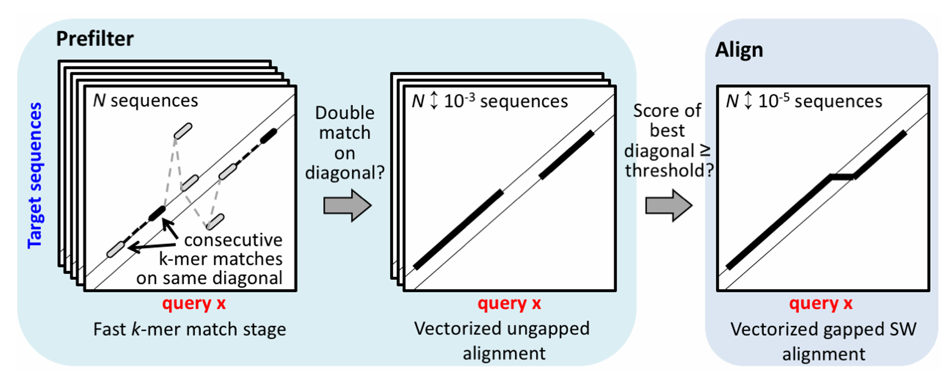
Alignment propagation
Steinegger, M., Söding, J. MMseqs2 enables sensitive protein sequence searching for the analysis of massive data sets. Nat Biotechnol 35, 1026–1028 (2017). https://doi.org/10.1038/nbt.3988

Slide 9
MMseqs2 vs other algorithms
Steinegger, M., Söding, J. MMseqs2 enables sensitive protein sequence searching for the analysis of massive data sets. Nat Biotechnol 35, 1026–1028 (2017). https://doi.org/10.1038/nbt.3988

